Slide 1

Project Jobez
- Apply today work tomorrow!
Team Name : Crew X
Arvind S
Yuvan S Subasri P
SujithKumar N Suhaina A
Mentor : Dr .Albert Raj

Slide 2


Introduction
Jobez- A marketplace where blue collar employees meet employers and small businesses

Slide 3
Contents
Introduction
Present Problems and Solution offered
Tech used
Development stage
Novelty Of Our Project
Future works
conclusion

Slide 4
Present Problems and solution offered

Slide 5
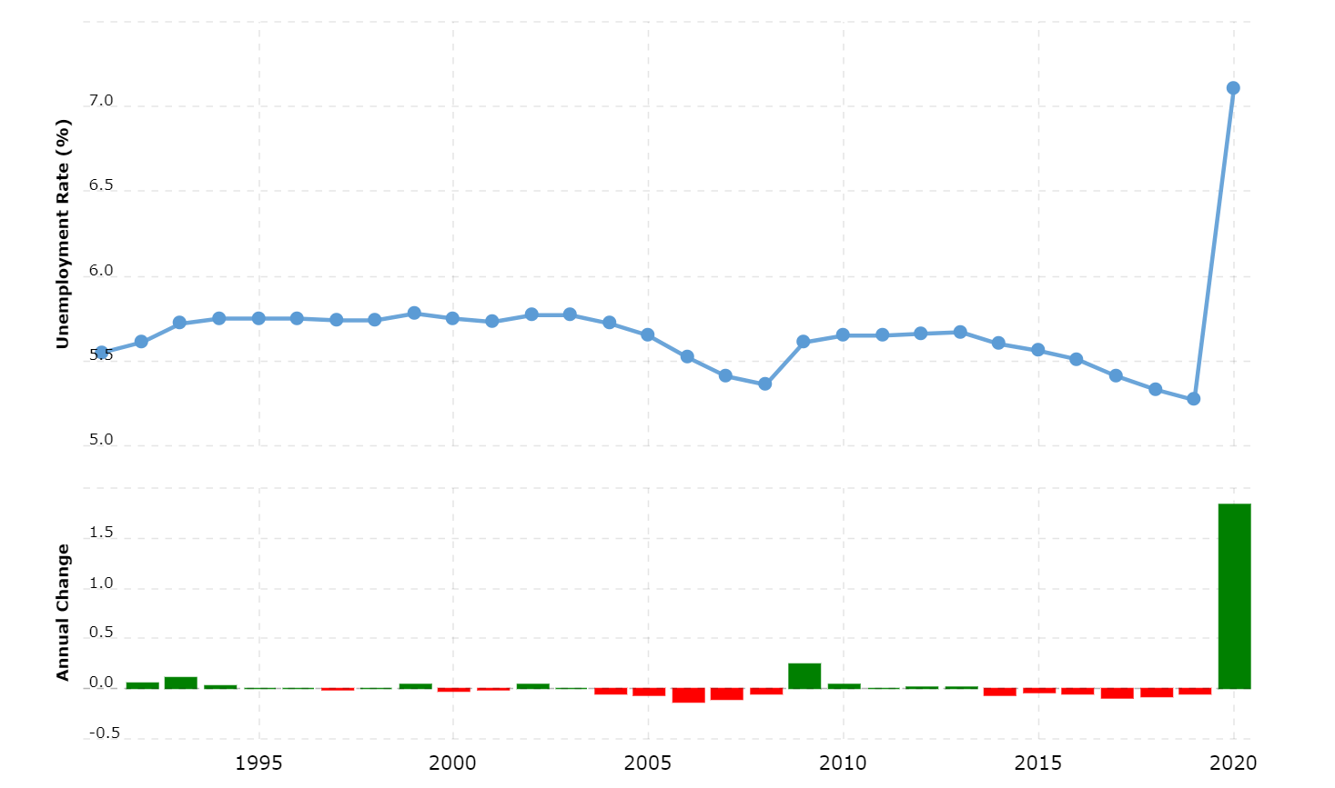
Unemployment
One of the main motto of our project is to reduce the unemployment rate.
India has about 53 million unemployed people as of December 2021,Of these, 35 million are the unemployed who are actively seeking work the Centre for Monitoring Indian Economy said.

Slide 6
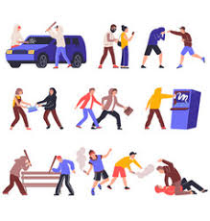
As a result of unemployment, idle youth are forced into criminal activities, such as armed robberies, drug trafficking, gambling and prostitution, in order to make ends meet. It causes social disruption in the society.
Due to unemployment, human resources go waste. If human resources are properly used, economic growth of the country will increase.

Slide 7
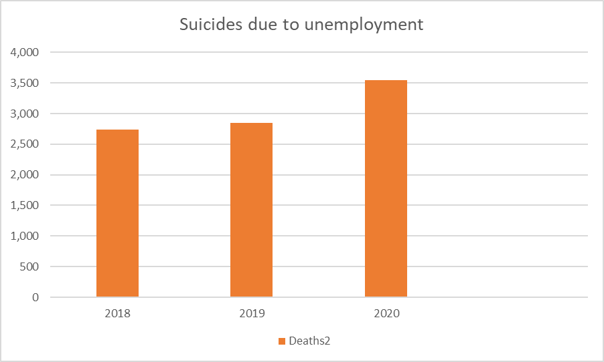
Unemployment leads to mental stress that may end up making the people to take wrong decisions.
3,548
It leads to reduced income which increases the burden of debt. Economic problems increase.
2,741
2,851

Slide 8
Elimination of middlemen
Problem:At present, the concept of middlemen is prevailing in employing blue-collar workers, which limits the workers from completing the work at the reasonable cost possible. This problem affects the consumers since they are paying more than the reasonable price for a particular work.
Solution:Our proposed application completely eliminates the middle-men system, thus enabling the workers to straight away bid on any project without giving any commission to anyone, this also gives a benefit to consumers that they can complete the work at a lowest and reasonable cost possible.

Slide 9

Cost Efficiency
Problem: Blue-collar jobs are Non-measurable so it is always difficult to cost them, there are enough chances that the consumer might be billed more than the reasonable price by the workers.
Solution:Our Proposed application has the bidding system in it, which enables the consumers to choose from a variety of costs that are bid by the workers thus the consumer can benefit by choosing the right and reasonable price.

Slide 10
Tech used
Flutter(Front-End):
Flutter is an open-source UI software development kit created by Google. It is used to develop cross platform applications for Android, iOS, Linux, Mac, Windows, Google Fuchsia, and the web from a single codebase.
Firebase(Back-End):
Firebase is a platform developed by Google for creating mobile and web applications. It was originally an independent company founded in 2011. In 2014, Google acquired the platform and it is now their flagship offering for app development

Slide 11
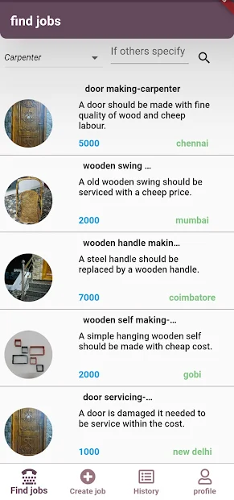
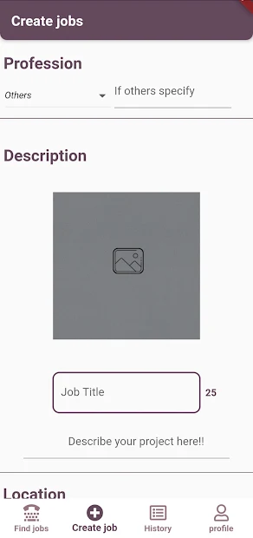
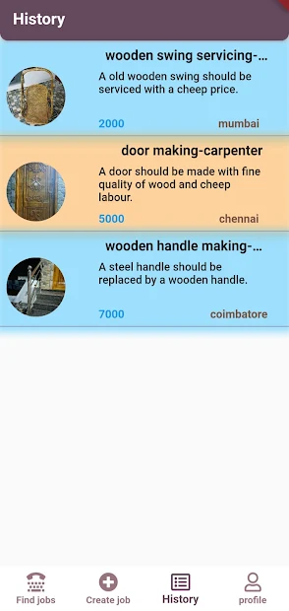
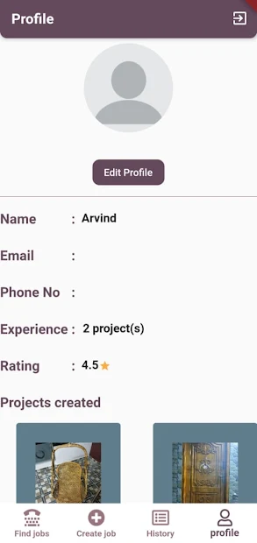
Development Stage

Slide 12
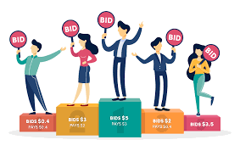
Novelty Of Our Project :
Job creation :
Our app is designed in such a way that every user has the access to create job. Hiring the workers is very easy.
Bidding system :
The special feature of the app is that workers can bid
their amount according to the work.

Slide 13
Future Upgradation
Low Storage Consumption
Language
Sorting
Rating
Location
Cost

Slide 14
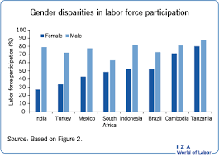
Conclusion
Impact of Jobez:
Formalisation of blue collar workforce.
Increase in female participation.
Preventing exploitation of child labor.
Access to health Insurance and basic amenities.
(sick leave, paid leave, legally bound contracts,etc)
Increase in taxes.
“Jobez , an utopian workplace for all blue-collared employees ”

Slide 15


